Slide 1
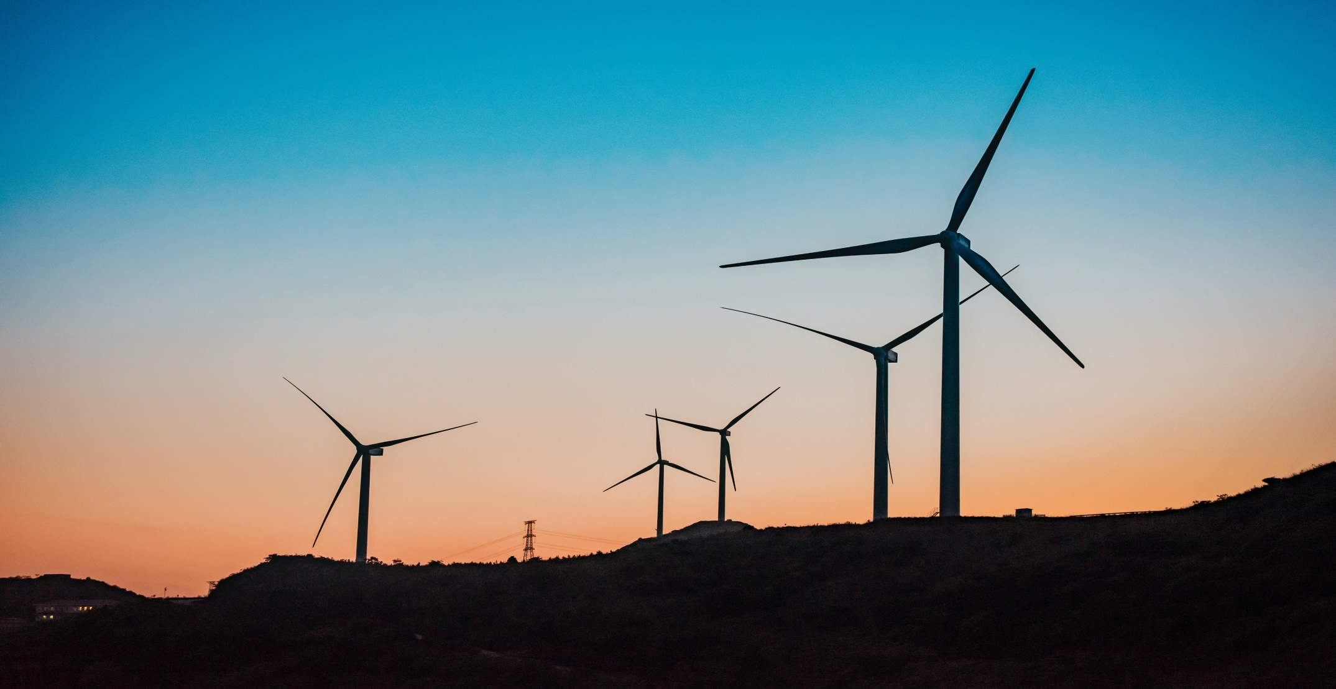
Predicting the Energy Output of wind turbine based on weather conditions

Slide 2
Index
Introduction of Team members
Road Map
Advantages and Disadvantages
Conclusion
References

Slide 3
Team Name: Mandarin
Member 1
Name: Harsh Chaurasia
College: IIT Indore
Member 2
Name: Ayush Saxena
College: IIT Kanpur
Member 3
Name: Bhaskar Jyoti Das
College: IIT Dhanbad
Member 4
Name: Bhavesh Kukreja
College: IIT Dhanbad

Slide 4
Road Map
2.Data
Collection
4.Model
Design
3.Data
Pre-processing
1.Work
Distribution
5.Application
Design

Slide 5
Work Distribution
Name: Harsh Chaurasia
Task: Application Design
Name: Ayush Saxena
Task: Model Design
Name: Bhaskar Jyoti Das
Task: Data Collection and Data Pre-processing
Name – Bhavesh Kukreja
Task: Data Collection and Data Pre-processing

Slide 6
Data Collection
We used the wind turbine dataset from Kaggle provided in the description of the problem and downloaded the weather conditions data of the same place and of the same time from the web.

Slide 7
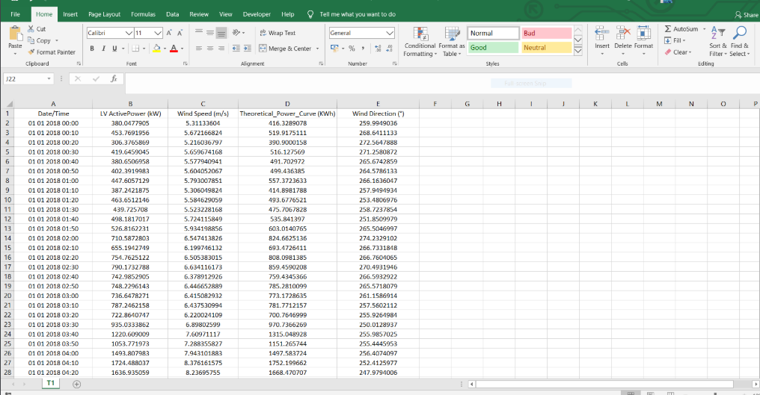
Kaggle Data

Slide 8
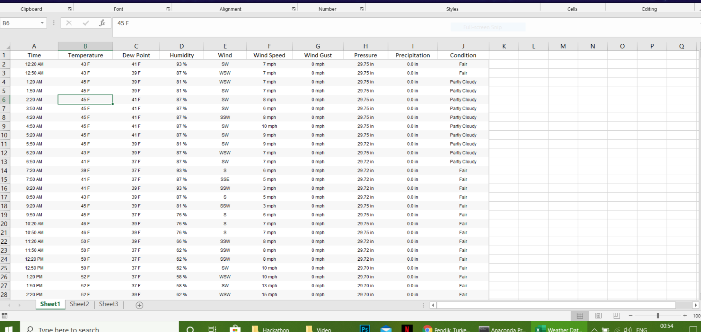
Weather Data

Slide 9
Data pre-processing
Activity 1 : Taking care of the missing data
Solution - The missing data is less than 5% of the total data so we have filled the missing data by the average value of the respective column data.
Activity 2 : Feature scaling
Solution - Weather data has a scale of 30 minutes while the wind turbine data from Kaggle has a scale of 10 minutes so in order to merge both the data's we have converted each of them into the same scale (i.e. scale of 30 minutes). Then we merged both the data's into one and obtained our final data.

Slide 10
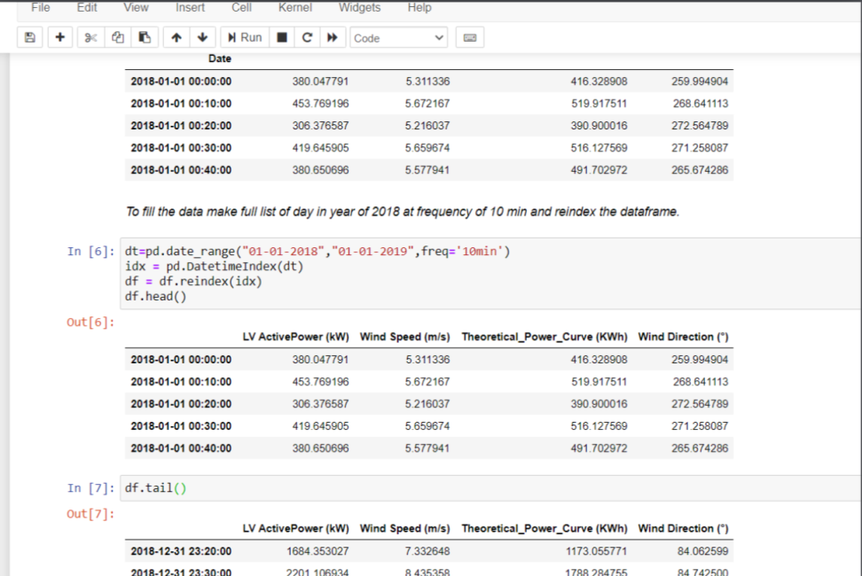
Code Screenshot
Handle Missing Data

Slide 11
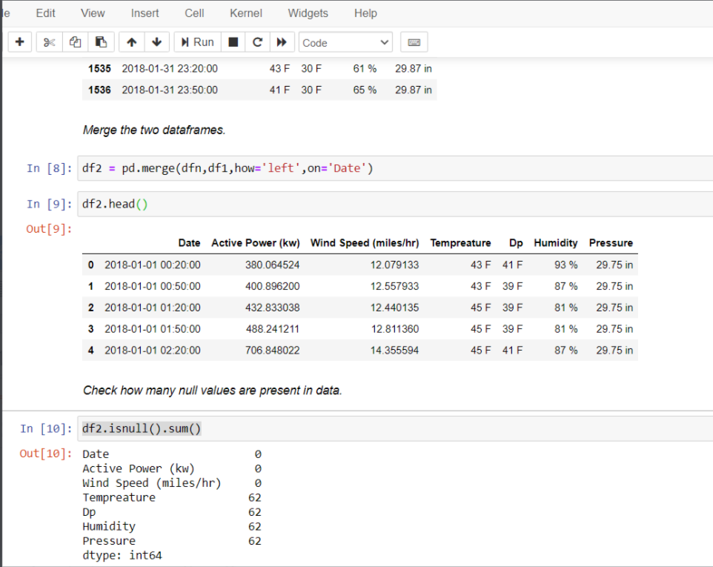
Code Screenshot
Merging of Data

Slide 12
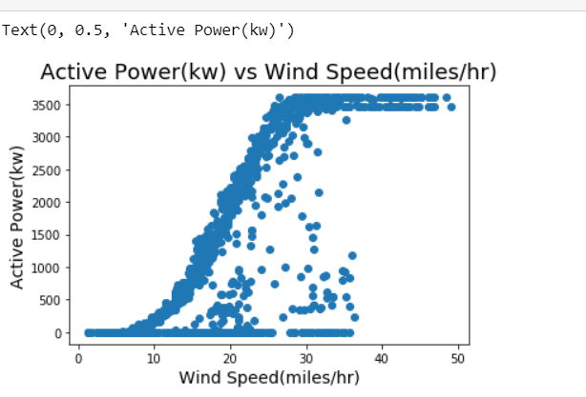
Activity 3: Visualization of the Data
Solution- We analyzed the data and studied the impact of different features on output (active power). With the results we achieved, we eradicated all the unnecessary features from the model

Slide 13
Model Design
Activity 1: Deciding parameters or features
Solution- With the results we achieved we have selected following as our features for the model :
1.Wind Speed
2.Temperature
3.Humidity
4.Pressure
Activity 2: Separating Training and Testing data from the data set
Solution- This process will be done inside the model file itself by using the train_test_split library in the sklearn package of python.
Activity 3: Developing the model
Solution- We use the boosted trees regressor model to train and evaluate the model using TensorFlow. We decided to train the model using 120 trees to optimize the model and preventing it from underfit also we have used entire batch of training data to train so that model can accurately be trained.

Slide 14
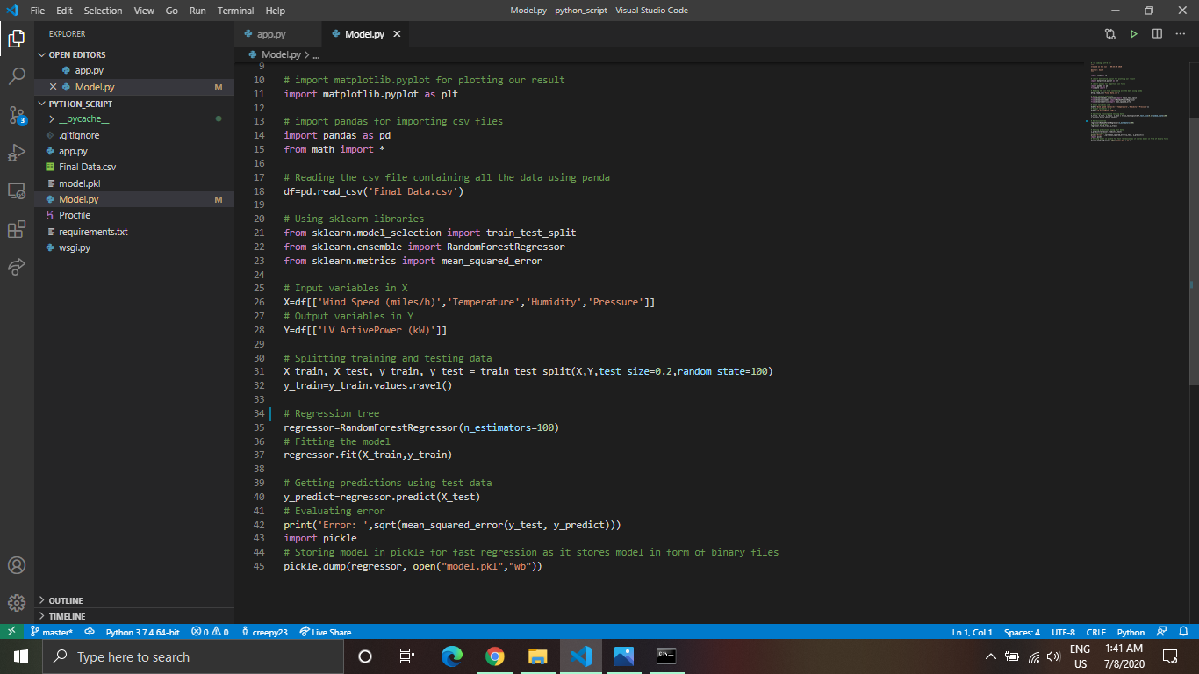
Screenshot of Boosted Tree Regressor Model Code

Slide 15
Application Design
Our initial plans included building the web app in Node-RED, but we wanted to provide our end-user the solution in single click, so we switched from Node-RED Web app to Android Application. We used Flutter framework for designing the UI of the app and Flask for the back-end.

Slide 16
Activity 1: Build the UI
Solution- We used Flutter framework to design our app. Flutter framework reduces code development time to huge extent because of its "hot reload" feature. It allows seeing the applied changes almost instantly, without even losing the current application state. Apart from this, development in Flutter is very easy because it uses the unique Widget tree model. Everything in Flutter UI is just a widget. "MaterialApp" widget is the root widget of the app and all the other widgets become its children in hierarchial pattern.

Slide 17
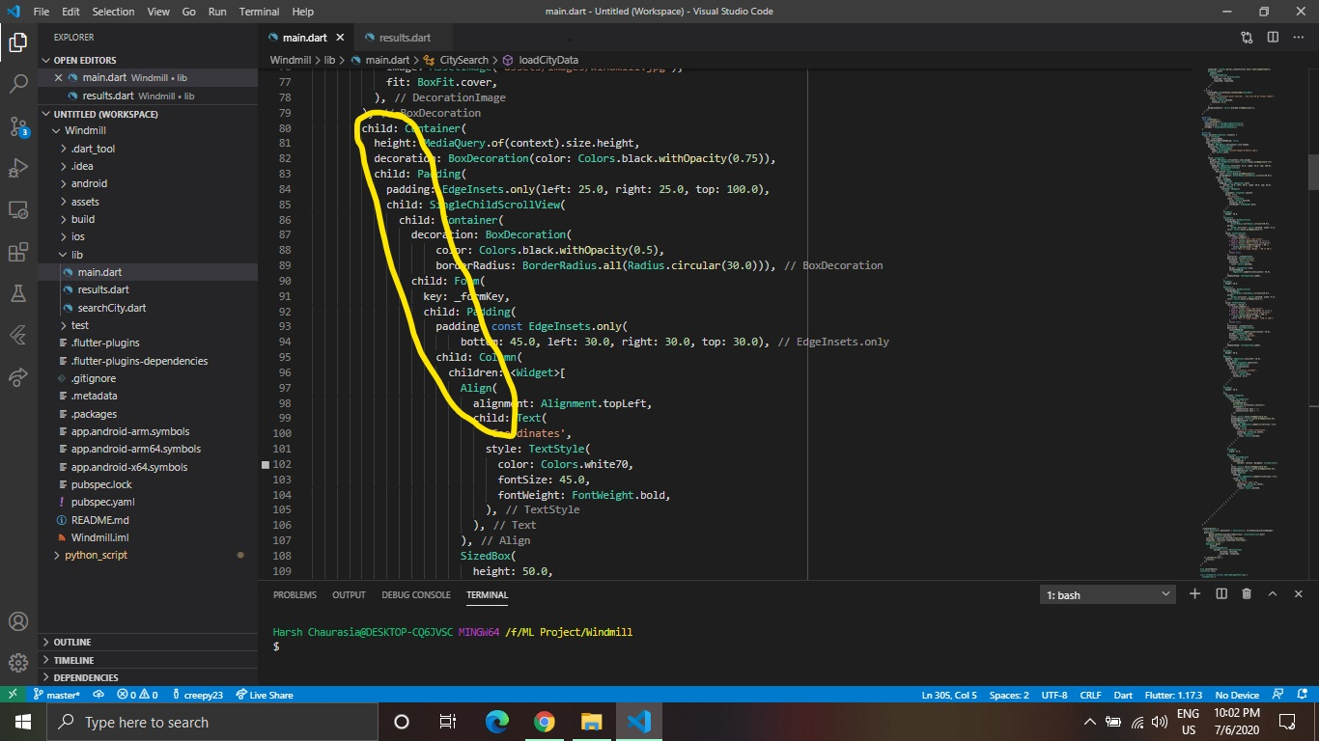
Screenshot of our code from Flutter displaying hierarchy

Slide 18
Flutter also has a huge library support for plugins and APIs along with detailed documentation of each on Flutter Dev and Pub Dev. Downloading and importing APIs in Flutter is a single line task.
A great emphasis has been put on developing the elegant UI of the app. We have used dark theme to decrease strain on eyes. Through our app we can predict the power generated by windmill for next 72 hours (on hourly basis) on any user input coordinates. User can also find the power generated on his/her live location using
"Use my location instead?" link in the app. User need to provide the app, location permissions to use this feature. Also a database of 13,000 cities in the world has been fed to the app which can be exploited using "Search for some city" button. User can search for the name of the cities and find the power that can be generated there. The app also provides the next 72 hour prediction of weather conditions at that particular coordinate.

Slide 19
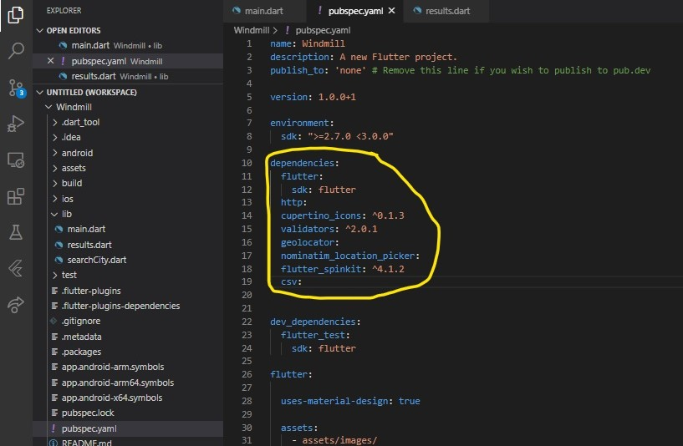
pubsec.yaml file contains all the dependencies of the app

Slide 20
Advantages and Disadvantages
ADVANTAGES
Weather Underground Services provide very accurate Historical Weather Data which increased the accuracy of model.
Mobile App is more convenient to use rather than web apps.
On giving location permissions, app can accurately predict power output at your live location.

Slide 21
DISADVANTAGES
Weather API is paid and the free version provide limited API requests per day.
Android App can't be deployed on IBM Cloud.
No free server available on IBM Cloud for deploying Backend.

Slide 22
Conclusion
In this project, we used Weather Underground services (subsidiary of IBM) to get accurate historical weather data. For merging this data with Windmill data we learned some Data Analysis concepts. We analyzed several ML models, and chose Random Tree Regressor to develop this model. This project gave us deep insight about the Flutter framework. We integrated the app with model and Weather API using REST API and Flask Back-end. The accuracy of Random Tree Regressor model for this project is 85%.

Slide 23
References
Wind Power Data:
https://www.kaggle.com/berkerisen/wind-turbine-scada-dataset
Weather Data
https://www.wunderground.com
Data Science
https://www.youtube.com/watch?v=CmorAWRsCAw&list=PLeo1K3hjS3uuASpe-1LjfG5f14Bnozjwy
Climacell API
https://www.climacell.co/weather-api/
Flask
https://flask.palletsprojects.com/en/1.1.x/
Flutter
https://flutter.dev/

